Slide 1
SQL 101
Mes premières commandes avec MySQL

Slide 2




Différentes versions of SQL
MysQL
PostgreSQL
Oracle SQL
SQL Server

Slide 3
MySQL
Simple
Facile de prise en main :
https://www.w3schools.com/sql/sql_where.asp
http://www.silota.com/docs/recipes/sql-top-n-group.html
https://www.javatpoint.com/mysql-tutorial
MySQL Database
MySQL Client (MySQL Workbench)

Slide 4
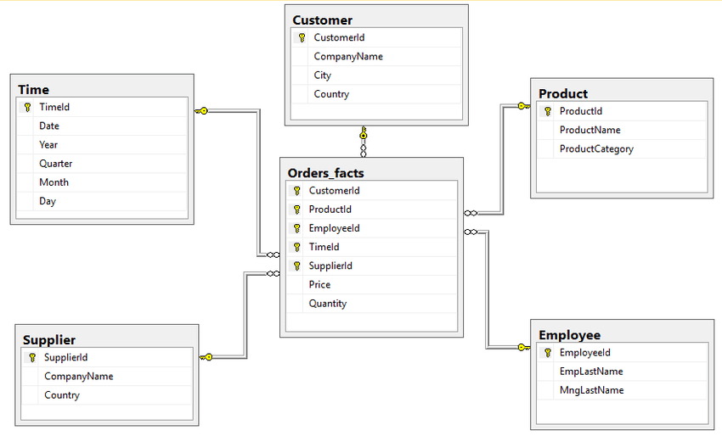
RDBMS ou SBDR
Definition
Example: Northwind database

Slide 5
PRIMARY KEY
The PRIMARY KEY constraint uniquely identifies each record in a table.
Primary keys must contain UNIQUE values, and cannot contain NULL values.
A table can have only ONE primary key; and in the table, this primary key can consist of single or multiple columns (fields).

Slide 6
FOREIGN KEY
A foreign key is a column or group of columns in a relational database table that provides a link between data in two tables. It acts as a cross-reference between tables because it references the primary key of another table, thereby establishing a link between them.

Slide 7
SELECT FROM

Slide 8
SELECT FROM WHERE

Slide 9
SELECT FROM WHERE + GROUP BY

Slide 10
SELECT FROM + WHERE + GROUP BY + HAVING

Slide 11
VIEWS

Slide 12
JOINS v.1

Slide 13
Export to CSV

Slide 14
ANACONDA : INSTALL

Slide 15
From MySQL to PANDAS
Install pymysql + follow the jupyter notebook.

